Slide 1

Secured Wireless USB Flash Drive
University of Dar es Salaam
Student’s name: | Kowero, Walidi Waziri
Registration No: | 2020-04-04390
Degree Programme: | B.Sc. Electronics Engineering
Supervisor: | Prof. Baraka Maiseli
Electronics and Telecommunications Engineering
ES 499: Final Year Project
01

Slide 2

Outline
University of Dar es Salaam
• Introduction
• The Existing System
• Weaknesses of the current system
• Main objective of the project
• Specific objectives
• Scope of the Project
• Methodology
• Project timeline
• Work done so far
Electronics and Telecommunications Engineering
ES 499: Final Year Project
02

Slide 3
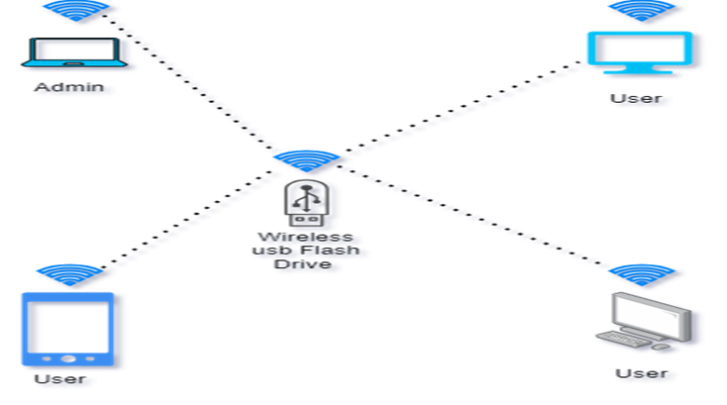
Introduction
University of Dar es Salaam
This project aim at increasing mobility and flexibility by using the existing radio technology, protocols to securely transfer data across devices
Electronics and Telecommunications Engineering
ES 499: Final Year Project
03

Slide 4
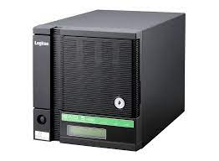
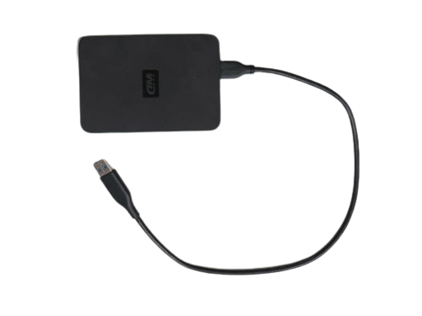
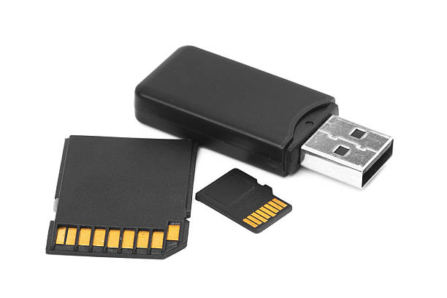
The existing system
University of Dar es Salaam
Most of the existing wireless USB flash drive uses middleware to perform data transfer.
Electronics and Telecommunications Engineering
ES 499: Final Year Project
04

Slide 5
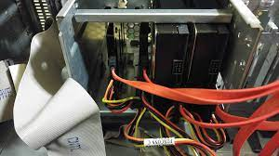
Weakness of the existing system
University of Dar es Salaam
Lack of suitable design of storage devices to suits the local markets needs.
Too much wires.
Unreliable data security.
Electronics and Telecommunications Engineering
ES 499: Final Year Project
05

Slide 6
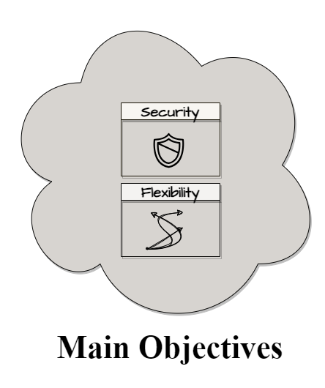
Main objective
University of Dar es Salaam
To enhance flexibility and security in wireless flash storage devices.
Electronics and Telecommunications Engineering
ES 499: Final Year Project
06

Slide 7
Specific objectives
University of Dar es Salaam
To enable reliable wireless data transfer
To implement secure ways of data transfer
To implement multipoint user-friendly interfaces
Electronics and Telecommunications Engineering
ES 499: Final Year Project
07

Slide 8

Scope of the project
University of Dar es Salaam
Local individuals using edge devices and personal computers.
Local companies and Institutes
Electronics and Telecommunications Engineering
ES 499: Final Year Project
08

Slide 9
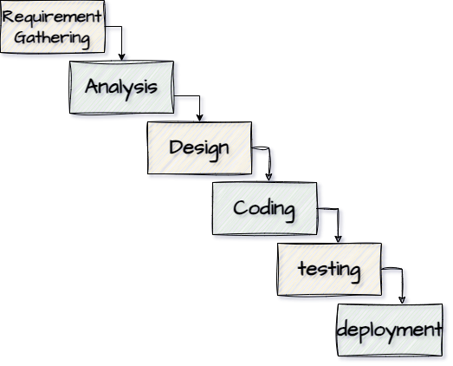
Methodology
University of Dar es Salaam
This project will be implemented using Water fall development method and will follow a bottom-up approach to achieve the main objective
Electronics and Telecommunications Engineering
ES 499: Final Year Project
09

Slide 10
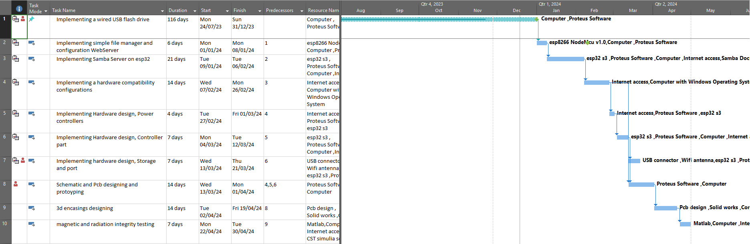
Project timeline
University of Dar es Salaam
Electronics and Telecommunications Engineering
ES 499: Final Year Project
10

Slide 11
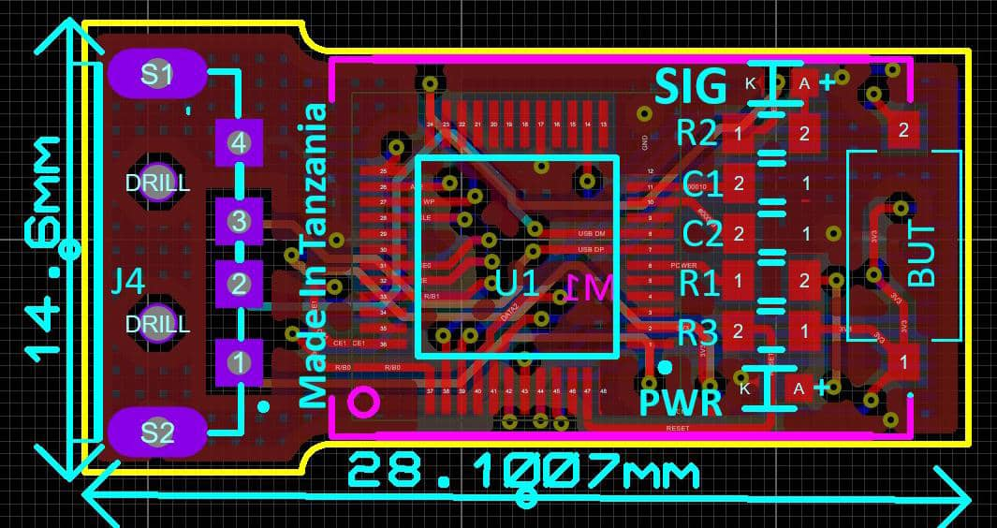
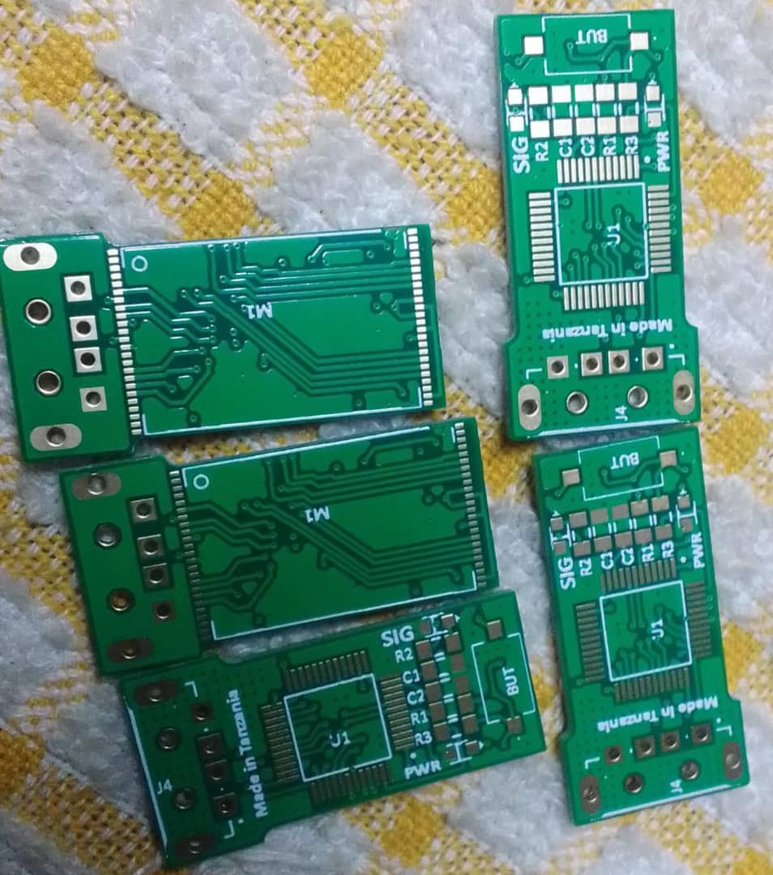
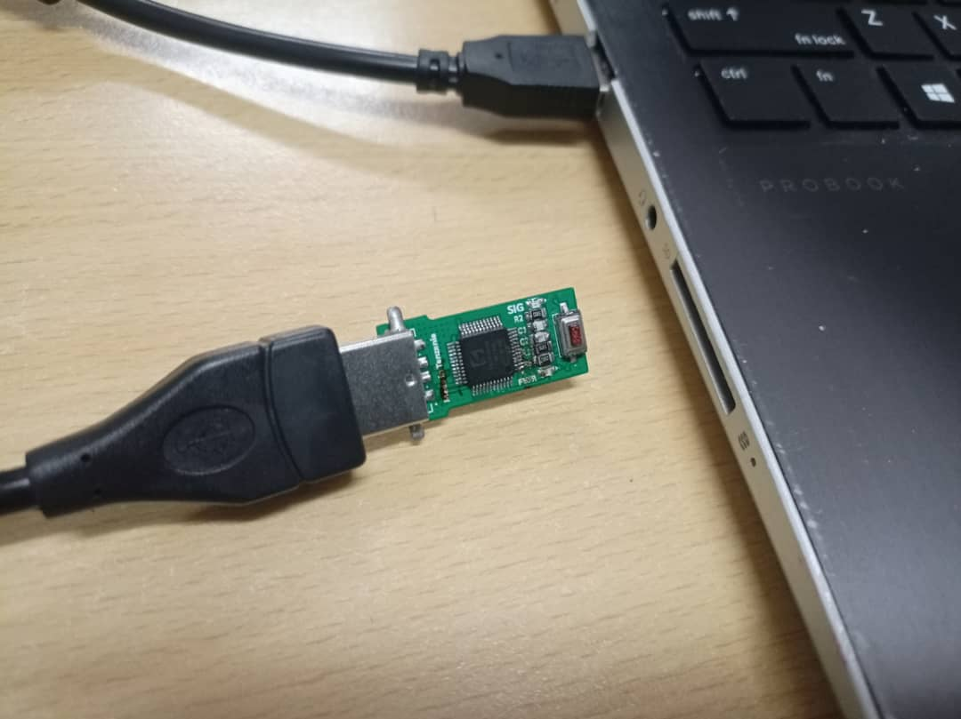
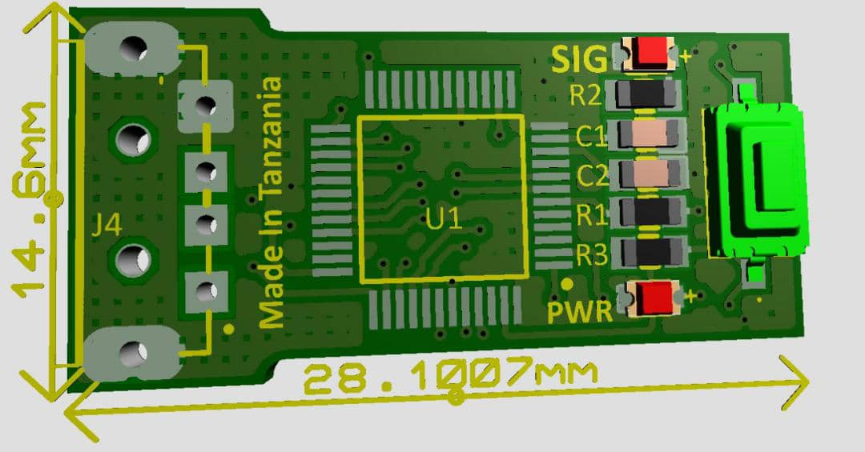
Work done so far
University of Dar es Salaam
Electronics and Telecommunications Engineering
ES 499: Final Year Project
11

Slide 12
Thank you!
University of Dar es Salaam
Electronics and Telecommunications Engineering
ES 499: Final Year Project
12

